Slide 1
Project Management System
Web Application

Slide 2
Problem Statement
Traditional Supervision Processes are not scalable
Supervisors are expected to guide their students over their dissertation work while engaging in administrative and other menial tasks, dividing the attention required to be productive, affecting both the student’s success and the institution’s credibility.
Reliance on inefficient practices
Ad-hoc meetings, lack of centralized management for project tasks, reviewing previous student work to verify if feedback has been applied and compiling progress log reports make up time consuming and mostly unproductive work that only increases with the number of students needed to supervise

Slide 3
Aims & Objectives
The objective is to develop a software in the management of final year projects.
The system should allow scheduling of meetings, sending reminders, allow students to submit their work in the form deliverables and resubmit any amended work if needed.
The system should use AI to determine if the work submitted has considered the feedback given and track the changes.
The software should also generate a progress log for the students and supervisors

Slide 4
How can the Project Management System streamline current academic supervision practices?
Centralized meeting scheduling system eliminates cognitive load required for tracking meetings.
Remain up-to-date with current projects with intuitive Project Management Interface
Intuitive interface for managing dissertation with notifications and reminders allow supervisors and students to always stay on track on the state of the project(s).
Automated Feedback Analysis reduces administrative workload of going over through previous tasks.
Analysing previous work for feedback compliance as opposed to providing feedback to a novel work is more of an administrative burden since it requires the supervisor to re-consider previous sections of the dissertation process.

Slide 5
Methodology
Literature Review
Conduct a background study to identify existing solutions
Analysis
Identify and evaluation of architectural choices for designing and implementing the application.
Design
Construct schemas (UML diagrams) to use as groundwork for implementation.
Implementation
Write and document the logic of the each of the application’s components.
Testing
Conduct unit tests alongside user acceptance testing.
Evaluation
Review tests and feedback from users

Slide 6
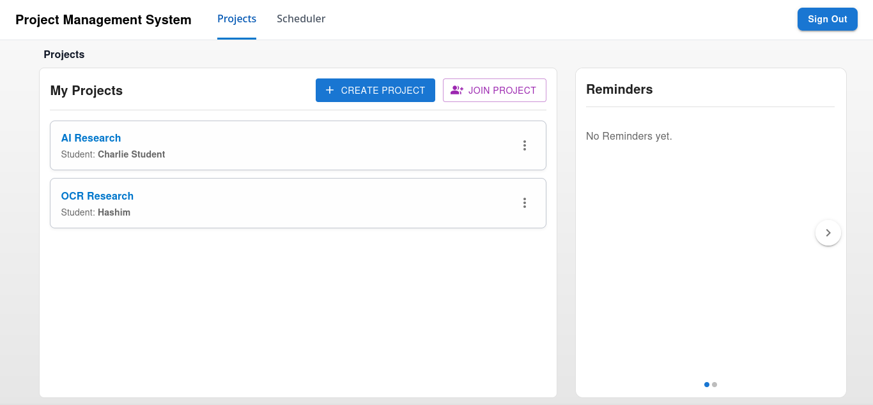
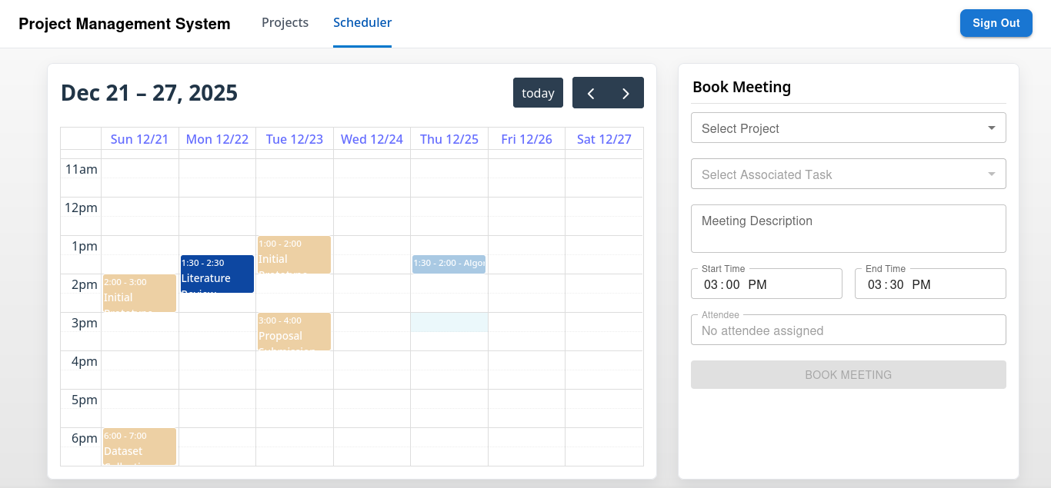
System Features
Project & Task Management
A dashboard will be provided to supervisors for creating projects and managing tasks while equally acting as an interface through which students can track their project.
Meeting Scheduling
A calendar scheduler to allow students to view their supervisor’s meetings and provide both users with the option to book/cancel meetings as organizers and accept/reject meetings as attendees.

Slide 7
System Features
AI Feedback Analysis
A generative AI system (multimodal LLM) that will automatically determine whether the resubmitted work of a student has applied the feedback specified by the supervisor.
Notification & Reminder Subsystem
A notification & reminder system to track project, meeting and other important actions.
Admin Dashboard
The system will provide a dedicated dashboard for admin users to create and view other users.
Progress Log Report Generation
Each project will provide the option to generate the progress log from meetings and task events for both the student and supervisor.

Slide 8
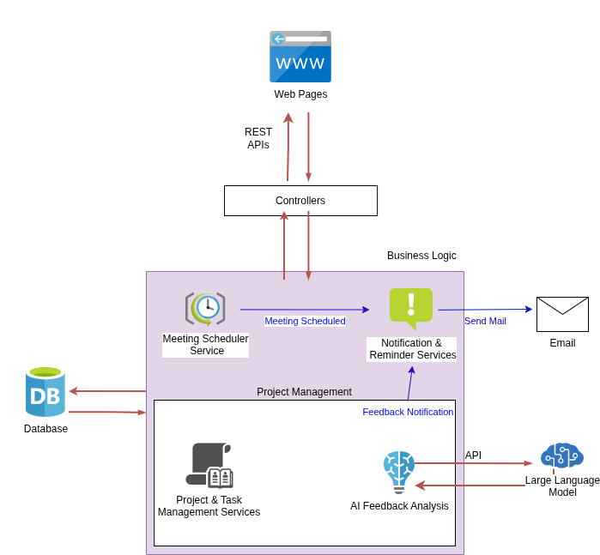

Architectural Diagram
Authentication
3-Tier Architecture
  Presentation Tier (Client Side)
  Application Tier (Server Side)
  Data Tier (Database)
Layer Separation
  The client will interact with the application server via HTTP requests (REST APIs)
  The application server will interact with the database via a database provider library.

Slide 9
Important Notes
AI Feedback Analysis Optimization
To minimize token usage, the text + vision model should only process the relevant sections of the previous and new document submissions to track changes and determine if feedback has been applied.
Evaluation: Colpali for Visual RAG
Colpali is a vision-based embedding model that retrieves the top-k document pages based on the document, for a given query.
However, the primary constraint is that it requires a minimum of 24gb of VRAM (GPU Memory) to run efficiently and is slower compared to the solution proposed.
Current Approach
No optimization currently used to determine relevant sections for processing.

Slide 10
Progress
Task | Status
Introduction | Done
Literature Review | Done
Analysis | Done
Design | Done
Implementation | In Progress
Testing | In Progress
Evaluation | To be Done after Implementation & Testing

Slide 11
Tools Used
Client (React w/ Typescript)
  React Router
  Library for page/route Navigation
  Fullcalendar
  Library for scheduler component
  Tanstack Query + ky
  Libraries for state management for HTTP requests
  Material UI
  Library for UI Components
Application Server (ASP.NET Core Web API)
  Entity Framework Core
  Object Relational Mapper for database
  Npgsql
  Entity Framework Core provider for Postgresql
  PdfPig
  Library for manipulating pdf documents
  Google Generative AI
  Library for working with Google Gemini API
Orchestration
  Docker
  Containerization software that turns services (client/server/database) into platform independent containers.
  Docker Compose
  Manage/Orchestrate docker containers
Database (Postgresql)

